Slide 1
Binary Search Tree
AVL Trees and Splay Trees
PUC-Rio
Eduardo S. Laber
Loana T. Nogueira

Slide 2
Binary Search Tree
Is a commonly-used data structure for storing and retrieving records in main memory

Slide 3
Binary Search Tree
Is a commonly-used data structure for storing and retrieving records in main memory
It guarantees logarithmic cost for various operations as long as the tree is balanced

Slide 4
Binary Search Tree
Is a commonly-used data structure for storing and retrieving records in main memory
It guarantees logarithmic cost for various operations as long as the tree is balanced
It is not surprising that many techniques that maintain balance in BSTs have received considerable attention over the years

Slide 5
Techniques:
AVL Trees
Splay Trees

Slide 6
How does the BST works?

Slide 7
How does the BST works?
Fundamental Property:
x

Slide 8
How does the BST works?
Fundamental Property:
x
y ≤ x

Slide 9
How does the BST works?
Fundamental Property:
x
y ≤ x
x ≤ z

Slide 10
Example: 50, 20, 39, 8, 79, 26, 58, 15,
88, 4, 85, 96, 71, 42, 53.
50
20
79
8
39
58
88
4
15
26
42
53
71
85
96

Slide 11
Relation between #nodes and height of a binary tree

Slide 12
Relation between #nodes and height of a binary tree
At each level the number of nodes duplicates, such that for a binary tree with height h we have at most:
  2⁰+ 2¹ + 2² + ...+ 2^{h-1} = 2^{h} – 1 nodes

Slide 13
Relation between #nodes and height of a binary tree
At each level the number of nodes duplicates, such that for a binary tree with height h we have at most:
  2⁰+ 2¹ + 2² + ...+ 2^{h-1} = 2^{h} – 1 nodes
  Or equivalently:

Slide 14
Relation between #nodes and height of a binary tree
At each level the number of nodes duplicates, such that for a binary tree with height h we have at most:
  2⁰+ 2¹ + 2² + ...+ 2^{h-1} = 2^{h} – 1 nodes
  Or equivalently:
  A binary search tree with n nodes can have mininum height
  h = O( log n)

Slide 15
BST
The height of a binary tree is a limit for the time to find out a given node

Slide 16
BST
The height of a binary tree is a limit for the time to find out a given node
BUT...

Slide 17
BST
The height of a binary tree is a limit for the time to find out a given node
BUT...
It is necessary that the tree is balanced

Slide 18
BST
The height of a binary tree is a limit for the time to find out a given node
BUT...
It is necessary that the tree is balanced (“every” internal node has 2 children)

Slide 19
BST Algorithm
Algorithm BST(x)
  If x = root then “element was found”
  Else
  if x < root then search in the left subtree
  else
  search in the right subtree

Slide 20
Complexity of Seaching in balanced BST
O(log n)

Slide 21
Including a node in a BST
Add a new element in the tree at the correct position in order to keep the fundamental property.

Slide 22
Including a node in a BST
Add a new element in the tree at the correct position in order to keep the fundamental property.
Algorithm Insert(x, T)
If x < root then Insert (x, left tree of T) else
Insert (x, right tree of T)

Slide 23
Removing a node in a BST
SITUATIONS:
Removing a leaf
Removing an internal node with a unique child
Removing an internal node with two children

Slide 24
Removing a node in a BST
SITUATIONS:
Removing a leaf
Removing an internal node with a unique child
Removing an internal node with two children

Slide 25
Removing a Leaf
6
2
8
1
4
3

Slide 26
Removing a Leaf
6
2
8
1
4
3

Slide 27
Removing a Leaf
6
6
2
8
2
8
1
4
1
4
3

Slide 28
Removing a node in a BST
SITUATIONS:
Removing a leaf
Removing an internal node with a unique child
Removing an internal node with two children

Slide 29
Removing an internal node with a unique child
It is necessary to correct the pointer, “jumping” the node: the only grandchild becomes the right son.

Slide 30
Removing an internal node with a unique child
6
2
8
1
4
3

Slide 31
Removing an internal node with a unique child
6
2
8
1
4
3

Slide 32
Removing an internal node with a unique child
6
2
8
1
4
3

Slide 33
Removing an internal node with a unique child
6
6
2
8
2
8
1
4
1
3
3

Slide 34
Removing a node in a BST
SITUATIONS:
Removing a leaf
Removing an internal node with a unique child
Removing an internal node with two children

Slide 35
Removing an internal node with two children
Find the element which preceeds the element to be removed considering the ordering
  (this corresponds to remove the element most to the right from the left subtree)

Slide 36
Removing an internal node with two children
6
2
8
1
4
3

Slide 37
Removing an internal node with two children
6
2
8
1
4
3

Slide 38
Removing an internal node with two children
6
6
2
8
2
8
1
4
1
4
3
3

Slide 39
Removing an internal node with two children
Find the element which preceeds the element to be removed considering the ordering
  (this corresponds to remove the element most to the right from the left subtree)
Switch the information of the node to be removed with the node found

Slide 40
Removing an internal node with two children
6
2
8
1
4
3

Slide 41
Removing an internal node with two children
6
4
2
8
2
8
1
4
1
6
3
3

Slide 42
Removing an internal node with two children
Find the element which preceeds the element to be removed considering the ordering
  (this corresponds to remove the element most to the right from the left subtree)
Switch the information of the node to be removed with the node found
Remove the node that contains the information we want to remove

Slide 43
Removing an internal node with two children
4
2
8
1
6
3

Slide 44
Removing an internal node with two children
4
2
8
1
6
3

Slide 45
Removing an internal node with two children
4
4
2
8
2
8
1
6
1
6
3
3

Slide 46
The tree may become unbalanced

Slide 47
The tree may become unbalanced
Remove: node 8
6
2
8
1
4
3

Slide 48
The tree may become unbalanced
Remove: node 8
6
6
2
8
2
1
4
1
4
3
3

Slide 49
The tree may become unbalanced
Remove: node 8 Remove node 1
6
6
2
8
2
1
4
1
4
3
3

Slide 50
The tree may become unbalanced
Remove: node 8 Remove node 1
6
6
6
2
8
2
2
1
4
1
4
4
3
3
3

Slide 51
The tree may become unbalanced
The binary tree may become degenerate after operations of insertion and remotion: becoming a list, for example.

Slide 52
The tree may become unbalanced
The binary tree may become degenerate after operations of insertion and remotion: becoming a list, for example.
The access time becomes no longer logarithmic
  HOW TO SOLVE THIS PROBLEM???

Slide 53
Balanced Trees:
AVL Trees
Splay Trees
Treaps
Skip Lists

Slide 54
Balanced Trees:
AVL Trees
Splay Trees
Treaps
Skip Lists

Slide 55
AVL TREES
(Adelson-Velskii and Landis 1962)
BST trees that maintain a reasonable balanced tree all the time.
Key idea: if insertion or deletion get the tree out of balance then fix it immediately
All operations insert, delete,… can be done on an AVL tree with N nodes in O(log N) time (average and worst case!)

Slide 56
AVL TREES
(Adelson-Velskii and Landis)
AVL Tree Property: It is a BST in which the heights of the left and right subtrees of the root differ by at most 1 and in which the right and left subtrees are also AVL trees

Slide 57
AVL TREES
(Adelson-Velskii and Landis)
AVL Tree Property: It is a BST in which the heights of the left and right subtrees of the root differ by at most 1 and in which the right and left subtrees are also AVL trees
Height: length of the longest path from the root to a leaf.

Slide 58
AVL TREES
Example:
4
44
2
3
17
78
1
2
1
32
50
88
1
1
48
62
An example of an AVL tree where the heights are shown next to the nodes:

Slide 59
AVL TREES
Example:
4
44
2
3
17
78
1
2
1
32
50
88
1
1
48
62
An example of an AVL tree where the heights are shown next to the nodes:

Slide 60
AVL TREES
Example:
4
44
2
3
17
78
1
2
1
32
50
88
1
1
48
62
An example of an AVL tree where the heights are shown next to the nodes:

Slide 61
AVL TREES
(Adelson-Velskii and Landis)
Example:

Slide 62
Relation between #nodes and height of na AVL tree

Slide 63
Relation between #nodes and height of na AVL tree
Let r be the root of an AVL tree of height h
Let N_{h} denote the minimum number of nodes in an AVL tree of height h

Slide 64
Relation between #nodes and height of na AVL tree
Let r be the root of an AVL tree of height h
Let N_{h} denote the minimum number of nodes in an AVL tree of height h
T
r
T_{e}
T_{d}

Slide 65
Relation between #nodes and height of na AVL tree
Let r be the root of an AVL tree of height h
Let N_{h} denote the minimum number of nodes in an AVL tree of height h
T
r
T_{e}
T_{d}
h-1

Slide 66
Relation between #nodes and height of na AVL tree
Let r be the root of an AVL tree of height h
Let N_{h} denote the minimum number of nodes in an AVL tree of height h
T
r
T_{e}
T_{d}
h-1
h-1 ou h-2

Slide 67
Relation between #nodes and height of na AVL tree
Let r be the root of an AVL tree of height h
Let N_{h} denote the minimum number of nodes in an AVL tree of height h
T
r
  N_{h} ≥ 1 + N_{h-1} + N_{h-2}
T_{e}
T_{d}
h-1
h-1 ou h-2

Slide 68
Relation between #nodes and height of na AVL tree
  N_{h} ≥ 1 + N_{h-1} + N_{h-2}
≥ 2N_{h-2} + 1

Slide 69
Relation between #nodes and height of na AVL tree
  N_{h} ≥ 1 + N_{h-1} + N_{h-2}
≥ 2N_{h-2} + 1
≥ 2N_{h-2}

Slide 70
Relation between #nodes and height of na AVL tree
  N_{h} ≥ 1 + N_{h-1} + N_{h-2}
≥ 2N_{h-2} + 1
≥ 2N_{h-2}
≥ 2(2N_{h-4})

Slide 71
Relation between #nodes and height of na AVL tree
  N_{h} ≥ 1 + N_{h-1} + N_{h-2}
≥ 2N_{h-2} + 1
≥ 2N_{h-2}
≥ 2(2N_{h-4}) ≥ 2²(N_{h-4})

Slide 72
Relation between #nodes and height of na AVL tree
  N_{h} ≥ 1 + N_{h-1} + N_{h-2}
≥ 2N_{h-2} + 1
≥ 2N_{h-2}
≥ 2(2N_{h-4}) ≥ 2²(N_{h-4}) ≥ 2² (2 N_{h-6})

Slide 73
Relation between #nodes and height of na AVL tree
  N_{h} ≥ 1 + N_{h-1} + N_{h-2}
≥ 2N_{h-2} + 1
≥ 2N_{h-2}
≥ 2(2N_{h-4}) ≥ 2²(N_{h-4}) ≥ 2² (2 N_{h-6}) ≥ 2³ N_{h-6}

Slide 74
Relation between #nodes and height of na AVL tree
  N_{h} ≥ 1 + N_{h-1} + N_{h-2}
≥ 2N_{h-2} + 1
≥ 2N_{h-2}
≥ 2(2N_{h-4}) ≥ 2²(N_{h-4}) ≥ 2² (2 N_{h-6}) ≥ 2³ N_{h-6}
≥ 2^{i} N_{h-2i}

Slide 75
Relation between #nodes and height of na AVL tree
  N_{h} ≥ 1 + N_{h-1} + N_{h-2}
Cases:
h=1 → N_{h} = 1
h=2 → N_{h} = 2
≥ 2N_{h-2} + 1
≥ 2N_{h-2}
≥ 2(2N_{h-4}) ≥ 2²(N_{h-4}) ≥ 2² (2 N_{h-6}) ≥ 2³ N_{h-6}
≥ 2^{i} N_{h-2i}

Slide 76
Relation between #nodes and height of na AVL tree
  N_{h} ≥ 1 + N_{h-1} + N_{h-2}
Cases:
h=1 → N_{h} = 1
h=2 → N_{h} = 2
≥ 2N_{h-2} + 1
≥ 2N_{h-2}
≥ 2(2N_{h-4}) ≥ 2²(N_{h-4}) ≥ 2² (2 N_{h-6}) ≥ 2³ N_{h-6}
≥ 2^{i} N_{h-2i}
Solving the base case we get: n(h) > 2 ^{h/2-1}
Thus the height of an AVL tree is O(log n)

Slide 77
Relation between #nodes and height of na AVL tree
  N_{h} ≥ 1 + N_{h-1} + N_{h-2}
Cases:
h=1 → N_{h} = 1
h=2 → N_{h} = 2
≥ 2N_{h-2} + 1
≥ 2N_{h-2}
≥ 2(2N_{h-4}) ≥ 2²(N_{h-4}) ≥ 2² (2 N_{h-6}) ≥ 2³ N_{h-6}
≥ 2^{i} N_{h-2i}
We can also get to this limit by the
Fibonacci number (N_{h} =N_{h-1} + N_{h-2})
Solving the base case we get: n(h) > 2 ^{h/2-1}
Thus the height of an AVL tree is O(log n)

Slide 78
Height of AVL Tree
Thus, the height of the tree is O(logN)
  Where N is the number of elements contained in the tree
This implies that tree search operations
  Find(), Max(), Min()
  take O(logN) time.

Slide 79
Insertion in an AVL Tree
Insertion is as in a binary search tree (always done by expanding an external node)

Slide 80
Insertion in an AVL Tree
Insertion is as in a binary search tree (always done by expanding an external node)
Example:
44
17
78
32
50
88
48
62

Slide 81
Insertion in an AVL Tree
Insertion is as in a binary search tree (always done by expanding an external node)
Example:
Insert node 54
44
17
78
32
50
88
48
62

Slide 82
Insertion in an AVL Tree
Insertion is as in a binary search tree (always done by expanding an external node)
Example:
Insert node 54
44
44
17
78
17
78
32
50
88
32
50
88
48
62
48
62
54

Slide 83
Insertion in an AVL Tree
Insertion is as in a binary search tree (always done by expanding an external node)
Example:
Insert node 54
44
44
4
17
78
17
78
32
50
88
32
50
88
48
62
48
62
54

Slide 84
Insertion in an AVL Tree
Insertion is as in a binary search tree (always done by expanding an external node)
Example:
Insert node 54
44
44
4
17
78
17
78
32
50
3
88
32
50
88
48
62
48
62
54

Slide 85
Insertion in an AVL Tree
Insertion is as in a binary search tree (always done by expanding an external node)
Example:
Insert node 54
44
44
4
17
78
17
78
32
50
3
88
1
32
50
88
48
62
48
62
54

Slide 86
Insertion in an AVL Tree
Insertion is as in a binary search tree (always done by expanding an external node)
Example:
Insert node 54
44
44
4
17
78
17
78
32
50
3
88
1
32
50
88
48
62
48
62
54
Unbalanced!!

Slide 87
Insertion in an AVL Tree
Insertion is as in a binary search tree (always done by expanding an external node)
Example:
Insert node 54
44
44
4
17
78
17
78
32
50
3
88
1
32
50
88
48
62
48
62
54
Unbalanced!!

Slide 88
How does the AVL tree work?

Slide 89
How does the AVL tree work?
After insertion and deletion we will examine the tree structure and see if any node violates the AVL tree property

Slide 90
How does the AVL tree work?
After insertion and deletion we will examine the tree structure and see if any node violates the AVL tree property
  If the AVL property is violated, it means the heights of left(x) and right(x) differ by exactly 2

Slide 91
How does the AVL tree work?
After insertion and deletion we will examine the tree structure and see if any node violates the AVL tree property
  If the AVL property is violated, it means the heights of left(x) and right(x) differ by exactly 2
If it does violate the property we can modify the tree structure using “rotations” to restore the AVL tree property

Slide 92
Rotations
Two types of rotations
  Single rotations
    two nodes are “rotated”
  Double rotations
    three nodes are “rotated”

Slide 93
Localizing the problem
Two principles:
Imbalance will only occur on the path from the inserted node to the root (only these nodes have had their subtrees altered - local problem)
Rebalancing should occur at the deepest unbalanced node (local solution too)

Slide 94
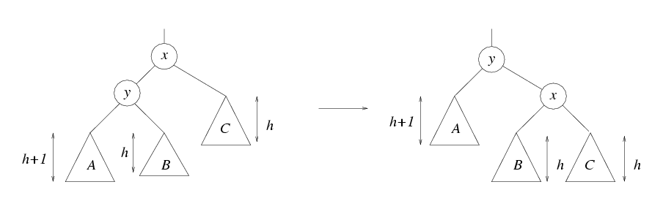
Single Rotation (Right)
Rotate x with left child y
(pay attention to the resulting sub-trees positions)

Slide 95
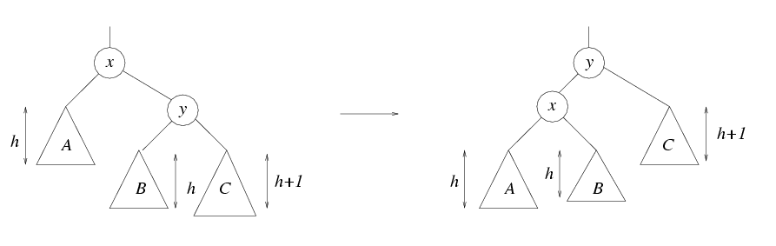
Single Rotation (Left)
Rotate x with right child y
(pay attention to the resulting sub-trees positions)

Slide 96
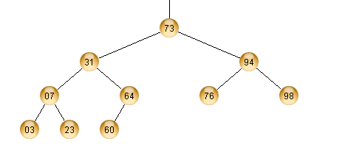
Single Rotation - Example
h
h+1
Tree is an AVL tree by definition.

Slide 97
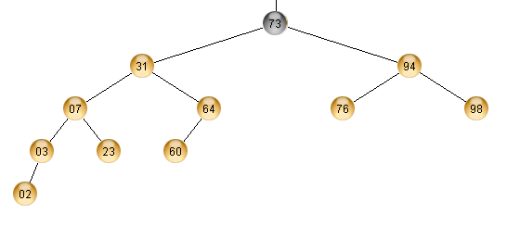
Example
h
h+2
Node 02 added
Tree violates the AVL definition!
Perform rotation.

Slide 98
Example
x
y
h
h+1
h
C
B
A
Tree has this form.

Slide 99
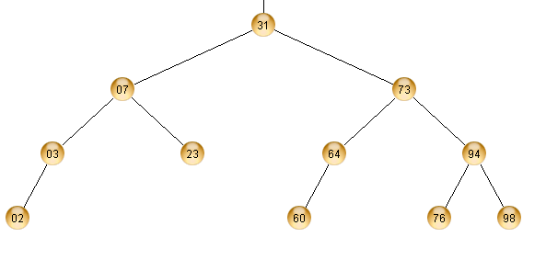
Example – After Rotation
y
x
A
B
C
Tree has this form.

Slide 100
Single Rotation
Sometimes a single rotation fails to solve the problem
k₂
k₁
k₁
k₂
Z
h
h
X
h+2
X
Y
Y
Z
h+2
In such cases, we need to use a double-rotation

Slide 101
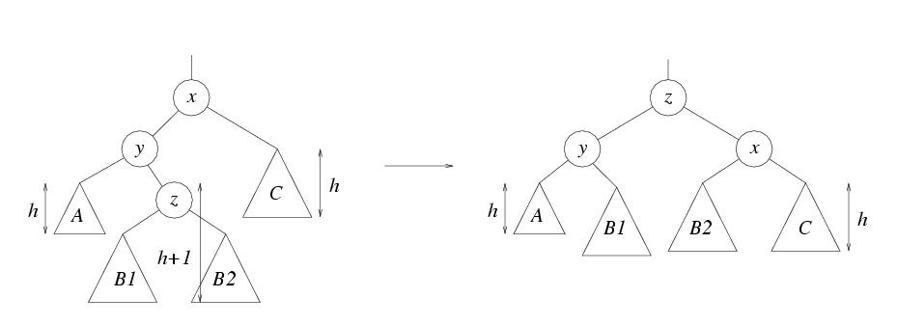
Double Rotations

Slide 102
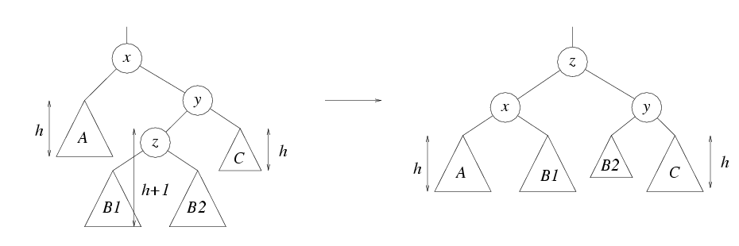
Double Rotations

Slide 103
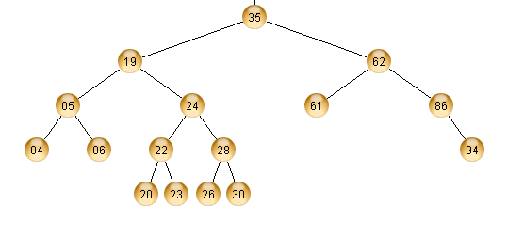
Double Rotation - Example
h
h+1
Delete node 94
Tree is an AVL tree by definition.

Slide 104
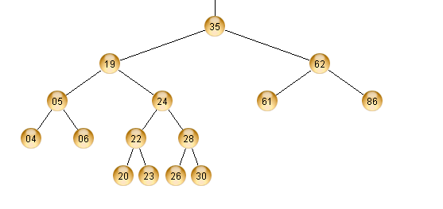
Example
h+2
h
AVL tree is violated.

Slide 105
Example
x
y
z
C
A
B1
B2
Tree has this form.

Slide 106
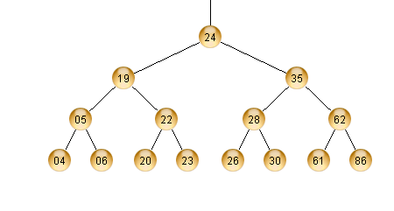
After Double Rotation
z
y
x
A
B1
B2
C
Tree has this form

Slide 107
Insertion
Part 1. Perform normal BST insertion
Part 2. Check and correct AVL properties
Trace from path of inserted leaf towards the root.
    Check to see if heights of left(x) and right(x) height differ at most by 1

Slide 108
Insertion
    If not, we know the height of x is h+3
      If the height of left(x) is h+2 then
        If the height of left(left(x)) is h+1, we single rotate with left child (case 1)
        Otherwise, the height of right(left(x)) is h+1 and we double rotate with left child (case 3)
      Otherwise, height of right(x) is h+2
        If the height of right(right(x)) is h+1, then we rotate with right child (case 2)
        Otherwise, the height of left(right(x)) is h+1 and we double rotate with right child (case 4)
* Rotations do not have to happen at the root! Remember to make the rotated node the new child of parent(x)

Slide 109
Insertion
The time complexity to perform a rotation is O(1)
The time complexity to find a node that violates the AVL property is dependent on the height of the tree, which is log(N)

Slide 110
Deletion
Perform normal BST deletion
Perform exactly the same checking as for insertion to restore the tree property

Slide 111
Summary AVL Trees
Maintains a Balanced Tree
Modifies the insertion and deletion routine
  Performs single or double rotations to restore structure
Guarantees that the height of the tree is O(logn)
  The guarantee directly implies that functions find(), min(), and max() will be performed in O(logn)

Slide 112
Example
h+2
h
AVL tree is violated.

Slide 113
Example
x
y
z
C
A
B1
B2
Tree has this form.

Slide 114
After Double Rotation
z
y
x
A
B1
B2
C
Tree has this form

Slide 115
Insertion
Part 1. Perform normal BST insertion
Part 2. Check and correct AVL properties
Trace from path of inserted leaf towards the root.
    Check to see if heights of left(x) and right(x) height differ at most by 1

Slide 116
Insertion
    If not, we know the height of x is h+3
      If the height of left(x) is h+2 then
        If the height of left(left(x)) is h+1, we single rotate with left child (case 1)
        Otherwise, the height of right(left(x)) is h+1 and we double rotate with left child (case 3)
      Otherwise, height of right(x) is h+2
        If the height of right(right(x)) is h+1, then we rotate with right child (case 2)
        Otherwise, the height of left(right(x)) is h+1 and we double rotate with right child (case 4)
* Rotations do not have to happen at the root! Remember to make the rotated node the new child of parent(x)

Slide 117
Insertion
The time complexity to perform a rotation is O(1)
The time complexity to find a node that violates the AVL property is dependent on the height of the tree, which is log(N)

Slide 118
Deletion
Perform normal BST deletion
Perform exactly the same checking as for insertion to restore the tree property

Slide 119
Summary AVL Trees
Maintains a Balanced Tree
Modifies the insertion and deletion routine
  Performs single or double rotations to restore structure
Guarantees that the height of the tree is O(logn)
  The guarantee directly implies that functions find(), min(), and max() will be performed in O(logn)

Slide 120
Summary AVL Trees
Requires a little more work for insertion and deletion
But, since trees are mostly used for searching
  More work for insert and delete is worth the performance gain for searching

Slide 121
Self-adjusting Structures
Consider the following AVL Tree
44
17
78
32
50
88
48
62

Slide 122
Self-adjusting Structures
Consider the following AVL Tree
44
17
78
32
50
88
48
62
Suppose we want to search for the following sequence of
elements: 48, 48, 48, 48, 50, 50, 50, 50, 50.

Slide 123
Self-adjusting Structures
Consider the following AVL Tree
In this case,
is this a good structure?
44
17
78
32
50
88
48
62
Suppose we want to search for the following sequence of
elements: 48, 48, 48, 48, 50, 50, 50, 50, 50.

Slide 124
Self-adjusting Structures
So far we have seen:
    BST: binary search trees
      Worst-case running time per operation = O(N)
      Worst case average running time = O(N)
        Think about inserting a sorted item list
    AVL tree:
      Worst-case running time per operation = O(logN)
      Worst case average running time = O(logN)
      Does not adapt to skew distributions

Slide 125
Self-adjusting Structures
The structure is updated after each operation

Slide 126
Self-adjusting Structures
The structure is updated after each operation
Consider a binary search tree. If a sequence of insertions produces a leaf in the level O(n), a sequence of m searches to this element will represent a time complexity of O(mn)

Slide 127
Self-adjusting Structures
The structure is updated after each operation
Consider a binary search tree. If a sequence of insertions produces a leaf in the level O(n), a sequence of m searches to this element will represent a time complexity of O(mn)
Use an auto-adjusting strucuture

Slide 128
Self-adjusting Structures
Splay Trees (Tarjan and Sleator 1985)
Binary search tree.
Every accessed node is brought to the root
Adapt to the access probability distribution

Slide 129
Self-adjusting Structures
We will now see a new data structure, called splay trees
      Worst-case running time of one operation = O(N)
      Worst case running time of M operations = O(MlogN)
        O(logN) amortized running time.
A splay tree is a binary search tree.

Slide 130
Splay Tree
A splay tree guarantees that, for M consecutive operations, the total running time is O(MlogN).
A single operation on a splay tree can take O(N) time.
  So the bound is not as strong as O(logN) worst-case bound in AVL trees.

Slide 131
Amortized running time
Definition: For a series of M consecutive operations:
  If the total running time is O(M*f(N)), we say that the amortized running time (per operation) is O(f(N)).
Using this definition:
  A splay tree has O(logN) amortized cost (running time) per operation.

Slide 132
Amortized running time
Ordinary Complexity: determination of worst case complexity. Examines each operation individually

Slide 133
Amortized running time
Ordinary Complexity: determination of worst case complexity. Examines each operation individually
Amortized Complexity: analyses the average complexity of each operation.

Slide 134
Amortized Analysis: Physics Approach
It can be seen as an analogy to the concept of potential energy

Slide 135
Amortized Analysis: Physics Approach
It can be seen as an analogy to the concept of potential energy
Potential function φ which maps any configuration E of the structure into a real number φ(E), called potential of E.

Slide 136
Amortized Analysis: Physics Approach
It can be seen as an analogy to the concept of potential energy
Potential function φ which maps any configuration E of the structure into a real number φ(E), called potential of E.
It can be used to to limit the costs of the operations to be done in the future

Slide 137
Amortized cost of an operation
a = t + φ(E’) - φ(E)

Slide 138
Amortized cost of an operation
_{Structure configuration}
_{after the operation}
a = t + φ(E’) - φ(E)
_{Real time}
_{of the operation}
_{Structure configuration}
_{before the operation}

Slide 139
Amortized cost of a sequence of operations
a = t + φ(E’) - φ(E)
_{m}
_{m}
Σ t _{i} = Σ (a_{i} - φ_{i} + φ_{i-1})
_{i=1}
_{i=1}

Slide 140
Amortized cost of a sequence of operations
a = t + φ(E’) - φ(E)
_{m}
_{m}
Σ t _{i} = Σ (a_{i} - φ_{i} + φ_{i-1})
_{i=1}
_{i=1}
By telescopic
_{m}
= φ₀ - φ_{m} + Σ a_{i}
_{i=1}

Slide 141
Amortized cost of a sequence of M operations
a = t + φ(E’) - φ(E)
_{m}
_{m}
Σ t _{i} = Σ (a_{i} - φ_{i} + φ_{i-1})
_{i=1}
_{i=1}
By telescopic
_{m}
= φ₀ - φ_{m} + Σ a_{i}
_{i=1}
The total real time does not depend on the intermediary potential

Slide 142
Amortized cost of a sequence of operations
Σ T_{i} = Σ (a_{i} - φ_{i} + φ_{i-1})
If the final potential is greater or equal than the initial, then the amortized complexity can be used as an upper bound to estimate the total real time.
_{i=1}
_{i=1}

Slide 143
Amortized running time
Definition: For a series of M consecutive operations:
  If the total running time is O(M*f(N)), we say that the amortized running time (per operation) is O(f(N)).
Using this definition:
  A splay tree has O(logN) amortized cost (running time) per operation.

Slide 144
Splay trees: Basic Idea
Try to make the worst-case situation occur less frequently.
    In a Binary search tree, the worst case situation can occur with every operation. (while inserting a sorted item list).
    In a splay tree, when a worst-case situation occurs for an operation:
      The tree is re-structured (during or after the operation), so that the subsequent operations do not cause the worst-case situation to occur again.

Slide 145
Splay trees: Basic idea
The basic idea of splay tree is:
    After a node is accessed, it is pushed to the root by a series of AVL tree-like operations (rotations).
    For most applications, when a node is accessed, it is likely that it will be accessed again in the near future (principle of locality).

Slide 146
Splay tree: Basic Idea
By pushing the accessed node to the root the tree:
  If the accessed node is accessed again, the future accesses will be much less costly.
  During the push to the root operation, the tree might be more balanced than the previous tree.
      Accesses to other nodes can also be less costly.

Slide 147
A first attempt
A simple idea
  When a node k is accessed, push it towards the root by the following algorithm:
    On the path from k to root:
      Do a singe rotation between node k’s parent and node k itself.

Slide 148
A first attempt
k₅
Accessing node k₁
k₄
F
k₃
E
k₂
D
k₁
A
B
B
access path

Slide 149
A first attempt
k₅
After rotation between k₂ and k₁
k₄
F
k₃
E
k₁
D
k₂
C
A
B

Slide 150
A first attempt
After rotation between k₃ and k₁
k₅
k₄
F
k₁
E
k₂
k₃
A
B
C
D

Slide 151
A first attempt
After rotation between k₄ and k₁
k₅
k₁
F
k₂
k₄
k₃
E
A
B
C
D

Slide 152
A first attempt
k₁
k₁ is now root
k₂
k₅
A
B
k₄
F
k₃
E
C
D
But k₃ is nearly as deep as k₁ was.
An access to k₃ will push some other node nearly as deep as k₃ is.
So, this method does not work ...

Slide 153
Splaying
The method will push the accessed node to the root.
  With this pushing operation it will also balance the tree somewhat.
  So that further operations on the new will be less costly compared to operations that would be done on the original tree.
A deep tree will be splayed:
    Will be less deep, more wide.

Slide 154
Splaying - algorithm
Assume we access a node.
We will splay along the path from access node to the root.
At every splay step:
  We will selectively rotate the tree.
  Selective operation will depend on the structure of the tree around the node in which rotation will be performed

Slide 155
Implementing Splay(x, S)
Do the following operations until x is root.
  ZIG: If x has a parent but no grandparent, then rotate(x).
  ZIG-ZIG: If x has a parent y and a grandparent, and if both x and y are either both left children or both right children.
  ZIG-ZAG: If x has a parent y and a grandparent, and if one of x, y is a left child and the other is a right child.

Slide 156
Implementing Splay(x, S)
Do the following operations until x is root.
  ZIG: If x has a parent but no grandparent, then rotate(x).
  ZIG-ZIG: If x has a parent y and a grandparent, and if both x and y are either both left children or both right children.
  ZIG-ZAG: If x has a parent y and a grandparent, and if one of x, y is a left child and the other is a right child.
y
x
C
A
B

Slide 157
Implementing Splay(x, S)
Do the following operations until x is root.
  ZIG: If x has a parent but no grandparent, then rotate(x).
  ZIG-ZIG: If x has a parent y and a grandparent, and if both x and y are either both left children or both right children.
  ZIG-ZAG: If x has a parent y and a grandparent, and if one of x, y is a left child and the other is a right child.
root
x
y
x
A
y
C
ZIG(x)
A
B
B
C

Slide 158
Implementing Splay(x, S)
Do the following operations until x is root.
  ZIG: If x has a parent but no grandparent, then rotate(x).
  ZIG-ZIG: If x has a parent y and a grandparent, and if both x and y are either both left children or both right children.
  ZIG-ZAG: If x has a parent y and a grandparent, and if one of x, y is a left child and the other is a right child.
root
y
x
y
A
x
C
ZAG(x)
A
B
B
C

Slide 159
Implementing Splay(x, S)
Do the following operations until x is root.
  ZIG: If x has a parent but no grandparent, then rotate(x).
  ZIG-ZIG: If x has a parent y and a grandparent, and if both x and y are either both left children or both right children.
  ZIG-ZAG: If x has a parent y and a grandparent, and if one of x, y is a left child and the other is a right child.
z
y
D
x
C
A
B

Slide 160
Implementing Splay(x, S)
Do the following operations until x is root.
  ZIG: If x has a parent but no grandparent, then rotate(x).
  ZIG-ZIG: If x has a parent y and a grandparent, and if both x and y are either both left children or both right children.
  ZIG-ZAG: If x has a parent y and a grandparent, and if one of x, y is a left child and the other is a right child.
z
x
y
D
A
y
ZIG-ZIG
x
C
B
z
A
B
C
D

Slide 161
Implementing Splay(x, S)
z
y
D
x
C
A
B

Slide 162
Implementing Splay(x, S)
y
z
y
D
z
x
x
C
A
B
C
D
A
B

Slide 163
Implementing Splay(x, S)
y
z
y
D
z
x
x
C
A
B
C
D
A
B

Slide 164
Implementing Splay(x, S)
y
x
z
y
A
y
D
z
x
x
B
z
C
A
B
C
D
A
B
C
D

Slide 165
Implementing Splay(x, S)
Do the following operations until x is root.
  ZIG: If x has a parent but no grandparent, then rotate(x).
  ZIG-ZIG: If x has a parent y and a grandparent, and if both x and y are either both left children or both right children.
  ZIG-ZAG: If x has a parent y and a grandparent, and if one of x, y is a left child and the other is a right child.
z
A
y
x
D
B
C

Slide 166
Implementing Splay(x, S)
Do the following operations until x is root.
  ZIG: If x has a parent but no grandparent, then rotate(x).
  ZIG-ZIG: If x has a parent y and a grandparent, and if both x and y are either both left children or both right children.
  ZIG-ZAG: If x has a parent y and a grandparent, and if one of x, y is a left child and the other is a right child.
z
x
A
y
z
y
ZIG-ZAG
x
D
A
B
C
D
B
C

Slide 167
Splay Example
Apply Splay(1, S) to tree S:
10
9
8
7
6
ZIG-ZIG
5
4
3
2
1

Slide 168
Splay Example
Apply Splay(1, S) to tree S:
10
9
8
7
6
ZIG-ZIG
5
4
1
2
3

Slide 169
Splay Example
Apply Splay(1, S) to tree S:
10
9
8
7
6
ZIG-ZIG
1
4
2
5
3

Slide 170
Splay Example
Apply Splay(1, S) to tree S:
10
9
8
1
ZIG-ZIG
6
4
7
2
5
3

Slide 171
Splay Example
Apply Splay(1, S) to tree S:
10
1
8
ZIG
6
9
4
7
2
5
3

Slide 172
Splay Example
Apply Splay(1, S) to tree S:
1
10
8
6
9
4
7
2
5
3

Slide 173
Apply Splay(2, S) to tree S:
1
2
10
1
8
8
4
10
6
9
3
6
9
Splay(2)
4
7
5
7
2
5
3

Slide 174
Splay Tree Analysis
Definitions.
  Let S(x) denote subtree of S rooted at x.
  |S| = number of nodes in tree S.
  μ(S) = rank = ⎣ log |S| ⎦.
  μ(x) = μ (S(x)).
2
S(8)
1
8
|S| = 10
μ(2) = 3
μ(8) = 3
μ(4) = 2
μ(6) = 1
μ(5) = 0
4
10
3
6
9
5
7

Slide 175
Splay Tree Analysis
Define the potential function

Slide 176
Splay Tree Analysis
Define the potential function
Associate a positive weight to each node v: w(v)

Slide 177
Splay Tree Analysis
Define the potential function
Associate a positive weight to each node v: w(v)
W(v)= ∑ w(y), y belongs to a subtree rooted at v

Slide 178
Splay Tree Analysis
Define the potential function
Associate a positive weight to each node v: w(v)
W(v)= ∑ w(y), y belongs to a subtree rooted at v
Rank(v) = log W(v)

Slide 179
Splay Tree Analysis
Define the potential function
Associate a positive weight to each node v: w(v)
W(v)= ∑ w(y), y belongs to a subtree rooted at v
Rank(v) = log W(v)
The tree potential is:
∑ rank(v)
^{∀v}

Slide 180
Upper bound for the amortized time of a complete splay operation
To estimate the time of a splay operation we are going to use the number of rotations

Slide 181
Upper bound for the amortized time of a complete splay operation
To estimate the time of a splay operation we use the number of rotations
Lemma:
The amortized time for a complete splay operation of a node x in a tree of root r is, at most,
1 + 3[rank(r) – rank(x)]

Slide 182
Upper bound for the amortized time of a complete splay operation
Proof: The amortized cost a is given by
a=t + φ_{after} – φ_{before}
t : number of rotations executed in the splaying

Slide 183
Upper bound for the amortized time of a complete splay operation
Proof: The amortized cost a is given by
a=t + φ_{after} – φ_{before}
a = o₁ + o₂ + o₃ + ... + o_{k}
o_{i} : amortized cost of the i-th operation during the splay ( zig or zig-zig or zig-zag)

Slide 184
Upper bound for the amortized time of a complete splay operation
Proof:
φ_{i} : potential function after i-th operation
rank_{i} : rank after i-th operation
o_{i} = t_{i} + φ_{i} – φ_{i-1}

Slide 185
Splay Tree Analysis
Operations
  Case 1: zig( zag)
  Case 2: zig-zig (zag-zag)
  Case 3: zig-zag (zag-zig)

Slide 186
Splay Tree Analysis
  Case 1: Only one rotation (zig)
r
root
x

Slide 187
Splay Tree Analysis
  Case 1: Only one rotation (zig)
r
root
x
w.l.o.g.
x
r
x
A
r
C
ZIG(x)
A
B
B
C

Slide 188
Splay Tree Analysis
  Case 1: Only one rotation (zig)
r
root
x
w.l.o.g.
x
r
x
A
r
C
ZIG(x)
A
B
B
C
After the operation only rank(x) and rank(r) change

Slide 189
Splay Tree Analysis
  Since potential is the sum of every rank:
  φ_{i} - φ_{i-1} = rank_{i}(r) + rank_{i}(x) – rank_{i-1}(r) – rank_{i-1}(x)

Slide 190
Splay Tree Analysis
  Since potential is the sum of every rank:
  φ_{i} - φ_{i-1} = rank_{i}(r) + rank_{i}(x) – rank_{i-1}(r) – rank_{i-1}(x)
  t_{i} = 1 (time of one rotation)

Slide 191
Splay Tree Analysis
  Since potential is the sum of every rank:
  φ_{i} - φ_{i-1} = rank_{i}(r) + rank_{i}(q) – rank_{i-1}(r) – rank_{i-1}(q)
  t_{i} = 1 (time of one rotation)
  Amort. Complexity:
  o_{i} = 1 + rank_{i}(r) + rank_{i}(x) – rank_{i-1}(r) – rank_{i-1}(x)

Slide 192
Splay Tree Analysis
  Amort. Complexity:
  o_{i} = 1 + rank_{i}(r) + rank_{i}(x) – rank_{i-1}(r) – rank_{i-1}(x)
x
r
x
A
r
C
ZIG(x)
A
B
B
C

Slide 193
Splay Tree Analysis
  Amort. Complexity:
  o_{i} = 1 + rank_{i}(r) + rank_{i}(x) – rank_{i-1}(r) – rank_{i-1}(x)
rank_{i-1}(r) ≥ rank_{i}(r)
x
r
x
A
r
C
ZIG(x)
A
B
B
C
rank_{i}(x) ≥ rank_{i-1}(x)

Slide 194
Splay Tree Analysis
  Amort. Complexity:
  o_{i} = 1 + rank_{i}(x) – rank_{i-1}(x)
rank_{i-1}(r) ≥ rank_{i}(r)
x
r
x
A
r
C
ZIG(x)
A
B
B
C
rank_{i}(x) ≥ rank_{i-1}(x)

Slide 195
Splay Tree Analysis
  Amort. Complexity:
  o_{i} = 1 + 3[ rank_{i}(x) – rank_{i-1}(x) ]
rank_{i-1}(r) ≥ rank_{i}(r)
q
r
q
A
r
C
ZIG(x)
A
B
B
C
rank_{i}(q) ≥ rank_{i-1}(q)

Slide 196
Splay Tree Analysis
  Case 2: Zig-Zig
z
x
y
D
A
y
ZIG-ZIG
x
C
B
z
A
B
C
D

Slide 197
Splay Tree Analysis
  Case 2: Zig-Zig
  o_{i} = 2 + rank_{i}(x) + rank_{i}(y)+rank_{i}(z) – rank_{i-1}(x) – rank_{i-1}(y) – rank_{i-1}(z)
z
x
y
D
A
y
ZIG-ZIG
x
C
B
z
A
B
C
D

Slide 198
Splay Tree Analysis
  Case 2: Zig-Zig
  o_{i} = 2 + rank_{i}(x) + rank_{i}(y)+rank_{i}(z) – rank_{i-1}(x) – rank_{i-1}(y) – rank_{i-1}(z)
z
rank_{i-1}(z)= rank_{i}(x)
x
y
D
A
y
ZIG-ZIG
x
C
B
z
A
B
C
D

Slide 199
Splay Tree Analysis
  Case 2: Zig-Zig
  o_{i} = 2 + rank_{i}(y)+rank_{i}(z) – rank_{i-1}(x) – rank_{i-1}(y)
z
x
y
D
A
y
ZIG-ZIG
x
C
B
z
A
B
C
D

Slide 200
Splay Tree Analysis
  Case 2: Zig-Zig
  o_{i} = 2 + rank_{i}(y)+rank_{i}(z) – rank_{i-1}(x) – rank_{i-1}(y)
z
rank_{i}(x) ≥ rank_{i}(y)
rank_{i-1}(y) ≥ rank_{i-1}(x)
x
y
D
A
y
ZIG-ZIG
x
C
B
z
A
B
C
D

Slide 201
Splay Tree Analysis
  Case 2: Zig-Zig
  o_{i} ≤ 2 + rank_{i}(x)+rank_{i}(z) – 2rank_{i-1}(x)
z
Convexity of log
x
y
D
A
y
ZIG-ZIG
x
C
B
z
A
B
C
D

Slide 202
Splay Tree Analysis
  Case 2: Zig-Zig
  o_{i} ≤ 3[ rank_{i}(x) – rank_{i-1}(x) ]
z
x
y
D
A
y
ZIG-ZIG
x
C
B
z
A
B
C
D

Slide 203
Splay Tree Analysis
  Case 3: Zig-Zag (same Analysis of case 2)
  o_{i} ≤ 3[ rank_{i}(x) – rank_{i-1}(x) ]

Slide 204
Splay Tree Analysis
  Putting the three cases together and telescoping
a = o₁ + o₂ + ... + o_{k} ≤ 3[rank(r)-rank(x)]+1

Slide 205
Splay Tree Analysis
  For proving different types of results we must set the weights accordingly

Slide 206
Theorem. The cost of m accesses is O(m log n), where n is the number of items in the tree
Splay Tree Analysis

Slide 207
Theorem. The cost of m accesses is O(m log n), where n is the number of items in the tree
Splay Tree Analysis
Proof:
        Define every weight as 1/n.
Then, the amortized cost is at most 3 log n + 1.
|φ | is at most n log n
Thus, by summing over all accesses we conclude that the cost is at most m log n + n log n

Slide 208
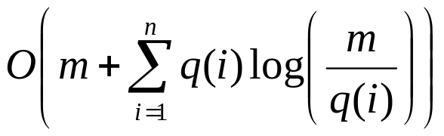
Static Optimality Theorem
Theorem: Let q(i) be the number of accesses to item i. If every item is accessed at least once, then total cost is at most

Slide 209
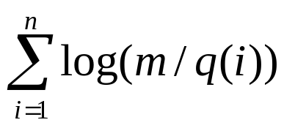
Static Optimality Theorem
Proof. Assign a weight of q(i)/m to item i. Then,
  rank(r)=0 and rank(i) ≥ log(q(i)/m)
  Thus, 3[rank(r) – rank(i)] +1 ≤ 3log(m/q(i)) + 1
In addition, |φ| ≤
Thus,

Slide 210
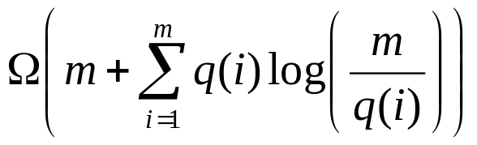
Static Optimality Theorem
Theorem: The cost of an optimal static binary search tree is

Slide 211
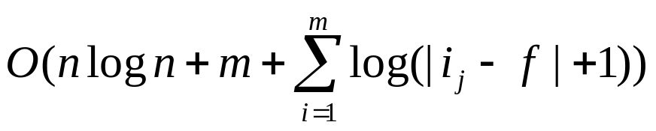
Static Finger Theorem
Theorem: Let i,...,n be the items in the splay tree. Let the sequence of accesses be i₁,...,i_{m}. If f is a fixed item, the total access time is

Slide 212
Static Finger Theorem
Proof. Assign a weight 1/(|i –f|+1)² to item i. Then,
  rank(r)= O(1).
  rank(i_{j})=O( log( |i_{j} – f +1|)
  Since the weight of every item is at least 1/n ², then
  |φ| ≤ n log n

Slide 213
Dynamic Optimality Conjecture
Conjecture Consider any sequence of successful accesses on an n-node search tree. Let A be any algorithm that carries out each access by traversing the path from the root to the node containing the accessed item, at a cost of one plus the depth of the node containing the item, and that between accesses performs an arbitrary number of rotations anywhere in the tree, at a cost of one per rotation. Then the total time to perform all the accesses by splaying is no more than O(n) plus a constant times the time required by the algorithm.

Slide 214
Dynamic Optimality Conjecture
_{Dynamic optimality - almost.}
E. Demaine, D. Harmon, J. Iacono, and M. Patrascu.
In Foundations of Computer Science (FOCS), 2004

Slide 215
Insertion and Deletion
_{Most of the theorems hold !}

Slide 216
Paris Kanellakis Theory and Practice Award Award 1999
_{Splay Tree Data Structure}
Daniel D.K. Sleator and Robert E. Tarjan
_{Citation}
  For their invention of the widely-used "Splay Tree" data structure.

